Slide 1
CHAPTER 3
ORGANIZATIONAL CULTURE AND ENVIRONMENT : THE CONSTRAINTS
by:
Umer Tariq
Notes:
http://www.slideshare.net/tanvirahmed9849912/chapter-3-management-9-th-edition-by-robbins-and-coulter

Slide 2
OUTLINE
The manager : Omnipotent or Symbolic
The Organizational Culture
Current Organizational Culture Issues Facing managers
The Environment

Slide 3
The managers : omnipotent or symbolic
Omnipotent view :
The view that managers are directly responsible for an organization’s success or failure
Symbolic view:
The view that much of an organization’s success or failure is due to external forces outside managers’ control
Notes:
Omnipotent view :
The view that managers are directly responsiblefor an organization’s success or failure
Symbolic view:
External forces are responsible for organization’s success or failure.
managers symbolize control and influence through their action.

Slide 4
ORGANIZATON’S CULTURE
“The shared values, principles, traditions, and ways of doing things that influence the way organizational members act. “
Culture includes:
Values
Symbols
rituals
myths
practices

Slide 5
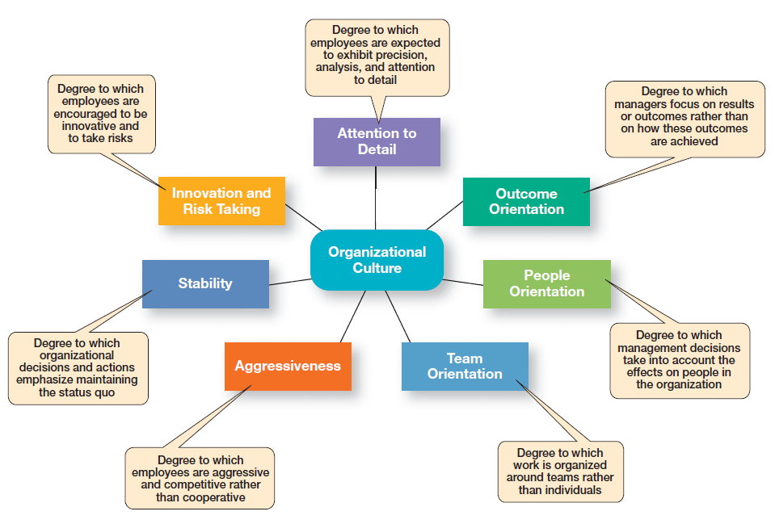
Dimensions of Organizational Culture

Slide 6
STRONG AND WEAK CULTURE
Strong Culture:
cohesion around beliefs, behavioral rules, traditions, and rituals.
Weak Culture:
beliefs, behavioral rules, traditions, and rituals are not apparent to its members

Slide 7
Sources of Organizational Culture:
Vision and mission
Past practices
Behavior of top management
Continuation of Organizational Culture:
Recruitment
Socialization

Slide 8
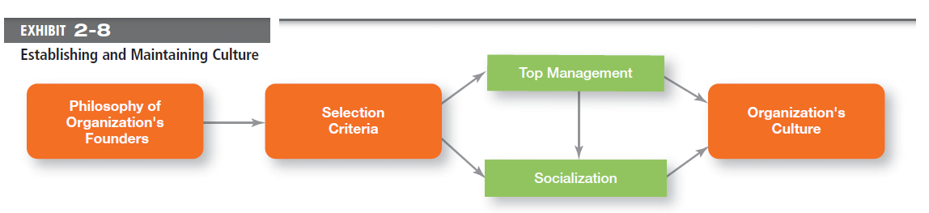

Slide 9
MANAGERIAL DECISIONS AFFECTED BY CULTURE
Planning
Organizing
Leading
Controlling
Notes:
Leadership types:
Democratic Leadership. ...
Strategic Leadership Style. ...
Transformational Leadership. ...
Team Leadership. ...
Cross-Cultural Leadership. ...
Facilitative Leadership. ...

Slide 10
Ethical Culture:
High in risk tolerance
Low to moderate aggressiveness
Focus on means as well as outcomes
Innovative Culture:
Challenges and involvement
Risk taking
Trust and openness

Slide 11
Spirituality and Organizational Culture
“The recognition that people have an inner life that nourishes and is nourished by meaningful work that takes place in the context of community.”
Characteristics of a spiritual Organization:
Sense of purpose
Individual development
Trust and openness
Employee empowerment

Slide 12
Spirituality and Organizational Culture (cont’D)
Benefits:
Improved employee productivity
Increased creativity
Increased employee satisfaction
Increased team performance
Increased organizational performance

Slide 13
External environment
“Those factors and forces outside the organization that affect the organization’s performance.”
Components of the External Environment:
Specific environment
General environment
Notes:
Specific environment: external forces that have a direct and immediate impact on the organization.
General environment: broad economic, socio-broad economic, socio- cultural, political/legal, demographic, technological and global conditions that may affect the organization.

Slide 14
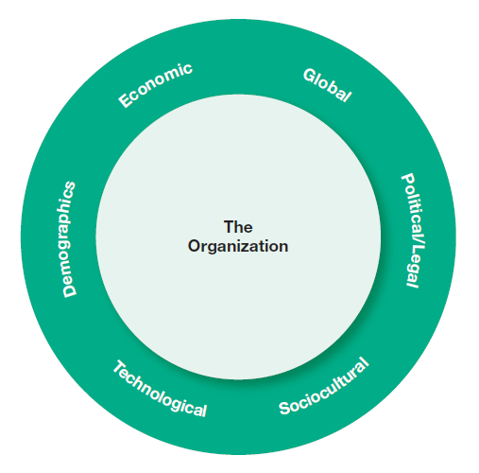

Slide 15
How the environment affects managers
Environmental uncertainty:
The extent to which managers have knowledge of and are able to predict change their organization’s external environment is affected by:
Complexity of the environment
Degree of change in environmental components
Notes:
The extent to which managers have knowledge of and are able to predict change their organization’s external environment is affected by:
Complexity of the environment: the number of components in an organization’s external environment.
Degree of change in environmental components: how dynamic or stable the external environment is.

Slide 16


